Slide 1

Abnormal Event Detection
Guide: Dr.Shylaja S S
Professor and Head of Department
Department of Information Science
PESIT,Bangalore
Team members:
Akshay Adiga : 1PI12IS009
Mahesh S K : 1PI12IS050
Prajwal P Vasisht : 1PI12IS073

Slide 2
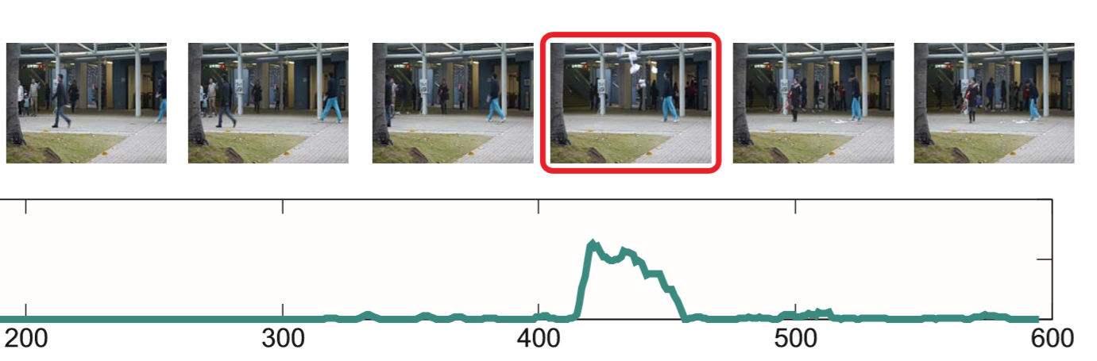
What is Abnormal Event?

Slide 3
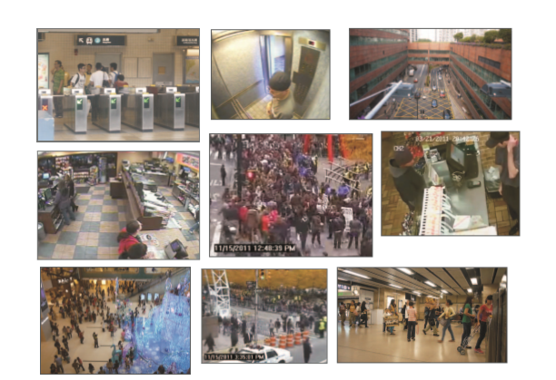
Video Frame Types Targeted

Slide 4
Problem Statement
Detection of abnormal events in a video.
Based on inherent redundancy of video structures, we propose an efﬁcient sparse combination learning framework.

Slide 5
Overall Process (Block diagram)
Gather input data set
Clean and preprocess data
Use input data to train model
Optimize model
Feed test data to detect abnormal events

Slide 6
Work Flow
Input
Data Pre-processing
Features
Training
S : Vector combination Learnt
Testing
Test Video
Output: Abnormal/Normal

Slide 7
Data Pre-Processing and Feature Extraction

Slide 8
Data Pre-Processing
Input : Video
Step 1 : Convert the video to frames
Video
cv2.imread()

Slide 9
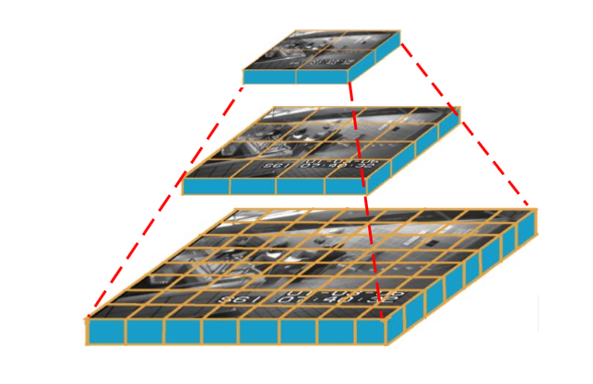
Data Pre-Processing contd..
Step 2 : For each frame, resize it to 3 scales
20x20
30x40
120x160
cv2.resize()

Slide 10
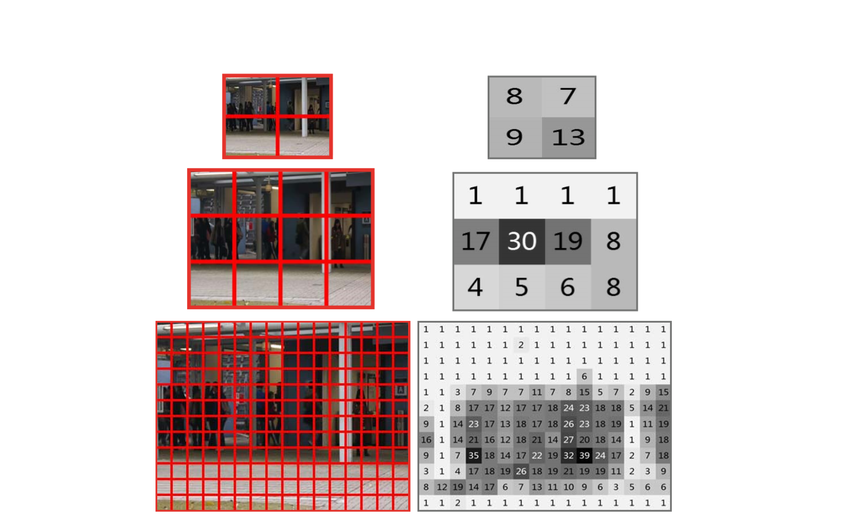
Data Pre-Processing contd..
Step 3 : Divide each scaled frame into equal non-overlapping region called patches
Each patch is 10x10
20x20
30x40
120x160

Slide 11
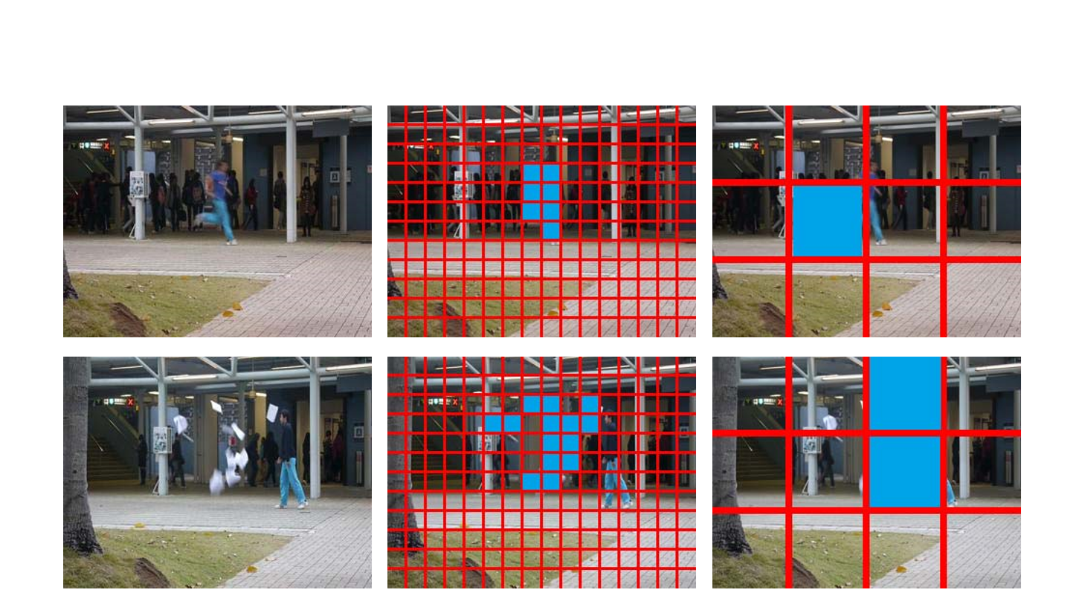
Why scaling?

Slide 12
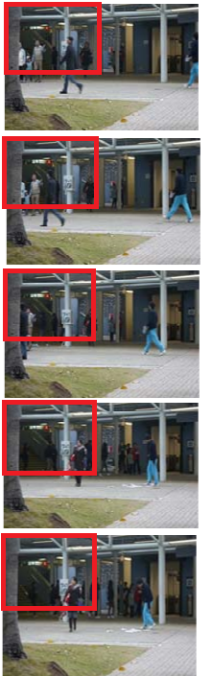
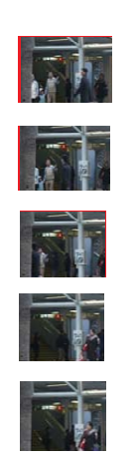
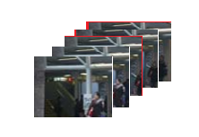
Data Pre-Processing contd..
Step 4 : Corresponding patches in 5 consecutive frames are stacked to form 10x10x5 3-D matrix called cube
Collect Patches
Stack to Cube

Slide 13
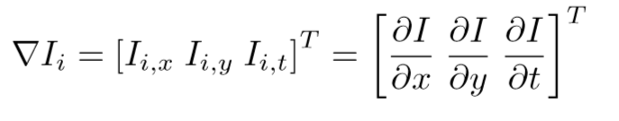
Data Pre-Processing contd..
Step 5 : For every 5 consecutive frames cube are formed and for each of these cube 3-D gradient feature is generated by applying sobel derivative function which is 1500 dimension
Output : Feature with 1500 dimension
Ready to be applied as input to Training

Slide 14
Training

Slide 15
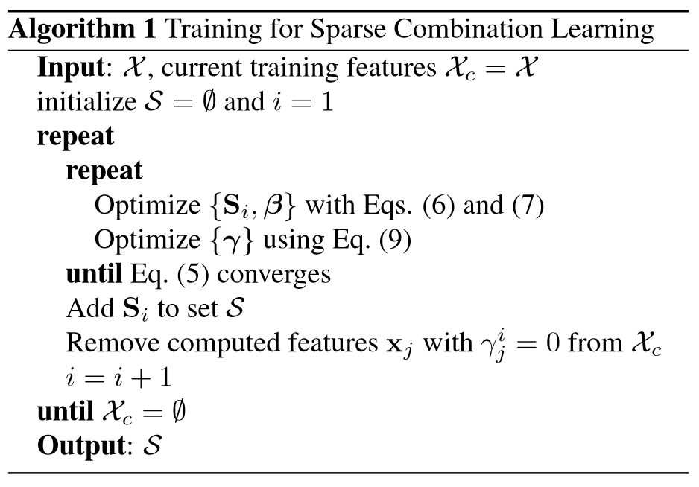
Training Algorithm

Slide 16
Training Explained..
N x 1500 dimension
x1
x2
K-means with
10 centers
1 x 10 dimension
x3
1
2
3
4
5
6
7
8
9
10
x4
Si Vector
(for each pass)
x5
xn
X (Feature vector)

Slide 17
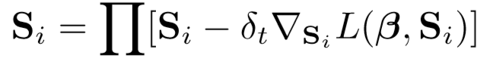
Training Explained..
Optimize Si
Delta t is set to 0.0001
Si is the initial Si vector
Delta Si is difference in L value in 2 iterations

Slide 18
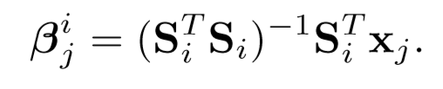
Training Explained..
Optimize Beta
Si is obtained vector in the previous equation
Xj is the current feature
This is calculated for each feature in the feature vector

Slide 19
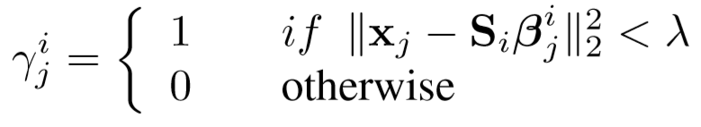
Training Explained..
Optimize Gamma
Si is obtained from equation 6
Xj is the current feature
Beta i is the vector obtained in the previous equation
Lamda is set to 0.04

Slide 20
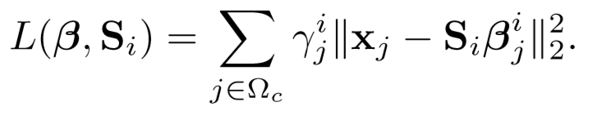
Training Explained..
Convergence based on L value
Using the parameters calculated previously L value is calculated
L denotes the energy and it decreases with each iteration
So when different in L value between 2 iteration is
Negative
Implies energy is decreased
Continue with the loop for convergence
Positive
Implies energy is increased
Converged - End the loop

Slide 21
Training Explained..
Change X and continue the process till X vector is empty
N x 1500 dimension
N x 1 dimension
N x 1500 dimension
x1
1
x1
x2
1
x2
x3
0
x4
1
x4
x5
0
x5
xn
1
xn
X (Feature vector)
Gamma
X (Feature vector)

Slide 22
Training Explained..
Change X and continue the process till X vector is empty
N x 1500 dimension
N x 1 dimension
x1
1
N-3 x 1500 dimension
x2
1
x1
x3
0
x2
x4
1
x4
x5
0
xn
xn
1
X (Feature vector)
X (Feature vector)
Gamma

Slide 23
Training Output
The Si at each iteration is collected to build up a set of vector
Learnt set of vectors S

Slide 24
Testing

Slide 25
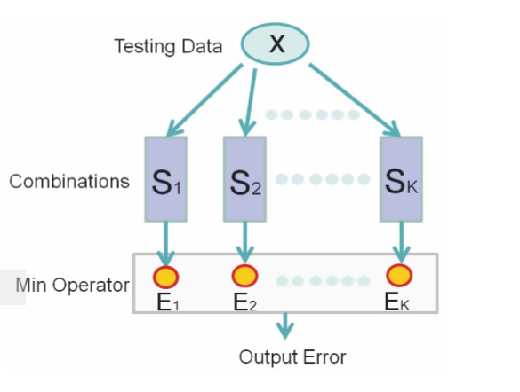
How is testing done?

Slide 26
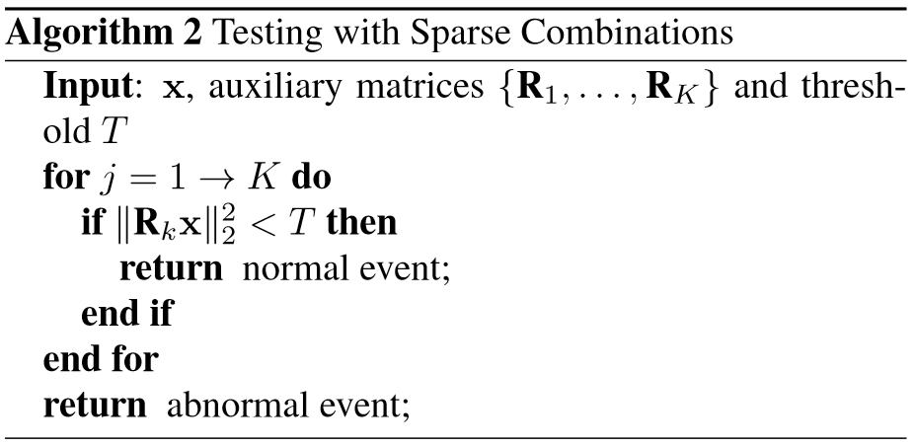
Testing Algorithm

Slide 27
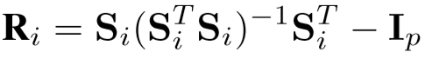
Testing Explained..
Building R
Auxiliary matrix
Si is individual vector in S
Ip is Identity matrix
Order same as Si

Slide 28
Testing Explained..
Input video is converted to features
Similar to Data-pre processing for training
For each xi vector in X
Ri vector in used to reconstruct xi
A threshold is set
If the Reconstruction error is very less, less than the threshold
It is concluded as normal event
Otherwise tat particular second is reported as an abnormal event

Slide 29
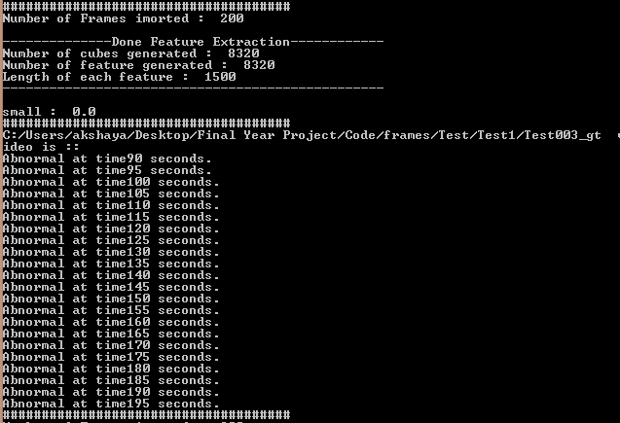
Training Output Example

Slide 30
Conclusion
We have presented an abnormal event detection method via sparse combination learning.
This approach directly learns sparse combinations, which increase the testing speed hundreds of times without compromising effectiveness.
Our method achieves good results. It is related to but differ largely from traditional subspace clustering

Slide 31
Future Works
Our future work will be to extend the sparse combination learning framework to other video applications.
This can be extended to detect various other kind of abnormal event that are usually encountered.
By doing this a system which can detect any abnormality will be build which can deployed in various environments just encouraging portability.
The algorithm should be carefully analyzed for areas where parallel processing is possible and suitably the algorithm should be tweaked which can help in achieving better accuracy.

Slide 32
Thank You!

